Slide 1
Presentation
Phase I of the Outage Inquiry
Board of Commissioners of Public Utilities
March 30, 2015

Slide 2
Hydro Team Members on Today’s Panel
Rob Henderson - Vice-President, Newfoundland and Labrador Hydro
Dawn Dalley – Vice-President, Corporate Relations and Customer Service
Paul Humphries - Vice-President, System Operations and Planning

Slide 3
Purpose of Presentation
Considerable information already on the record
  Initial Utility reports
  Liberty reports and PUB Interim Report
  Responses to Board and Intervener RFIs
  NLH and NP responses to Liberty’s Interim and Phase I reports
  Various reports and updates to the Board regarding actions taken in 2014
NL Hydro has substantially agreed with, and acted on, all Liberty and Board recommendations to date
This presentation addresses the specific areas of interest previously indicated by the other presenters or indicated as potential areas of cross-examination

Slide 4
Outline
Background
Outage Coordination and Communication
Customer Service
The Holyrood Combustion Turbine
Conclusion

Slide 5
Background
Rotating outages required during the period January 2-8
Significant customer impact
Ongoing coordination between NL Hydro and Newfoundland Power
Internal investigation of the events included a specific review of outage coordination and communication, and customer service
Accepted the Liberty and initial Board recommendations in this regard
Recognize the necessity of thorough and timely reporting and notice to customers and all stakeholders, including the Board, with respect to potential service disruption and restoration status
Internal investigation also focussed, in part, on short-term load forecasting, generation planning and winter readiness
Accepted the initial Liberty and Board recommendations to add additional capacity to Hydro’s system for the winter of 2014/15

Slide 6
Outage Coordination and Communication – System Operations
Ongoing contact between Hydro and Newfoundland Power Control Centres
System Operating Instruction T-001 - Generation Reserves - revised to improve coordination on reserve levels and to incorporate early notifications to stakeholders
Newfoundland Power provided with expanded access to real-time system data

Slide 7
Outage Coordination and Communication
Communications principles grounded by our core values:
  Open Communication
  Honesty and Trust
  Respect and Dignity
  Teamwork
Communications objective
  to be transparent and accessible, providing timely information to all stakeholders

Slide 8
Outage Coordination and Communication
During supply events, regular stream of information provided through:
  Media interviews
  Social media
  Media advisories
  Website updates and takeover page
  Daily press conferences
  Energy conservation advertising campaign

Slide 9
Outage Coordination and Communication – Post Event
Implemented a joint Storm/Outage Communication Plan:
  Outlines roles and responsibilities
  Processes for inter-utility sign-off on information
  Communications activities and timelines
  Key messages and templates
  Key contact information
  Links to new Advance Notification Protocol
Advance Notification Protocol implemented jointly with Newfoundland Power for advance customer notifications related to conservation requests and pending supply issues

Slide 10
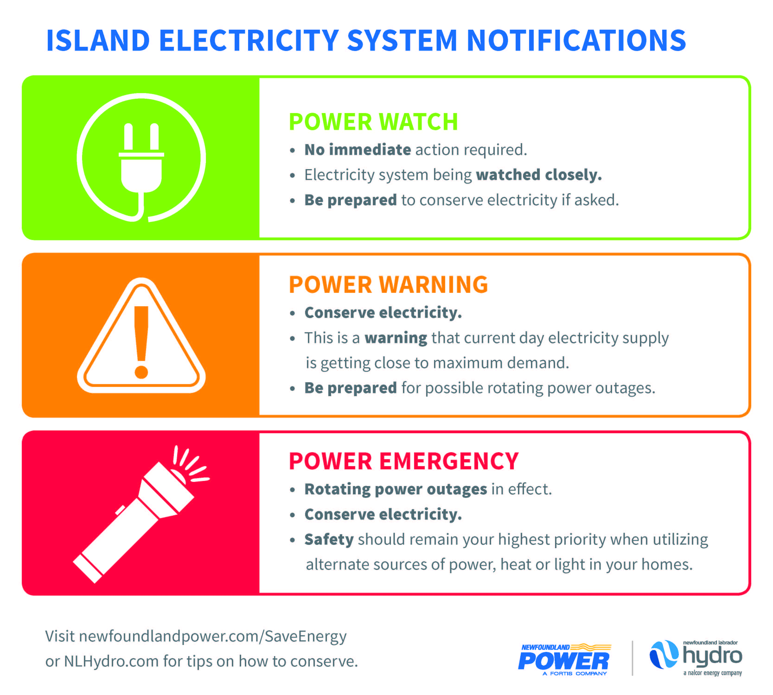
T-001 Level 2
24 Hour Generation Reserve Forecast – reserves less than largest gen. unit
T-001 Level 3
Current day Generation Reserve Margin less than half largest gen. unit
T-001 Level 4
Generation Shortfall Imminent – No Reserve Margins

Slide 11
Customer Service
Updated Hydro’s list of priority feeders, identified sensitive customers, and developed a feeder rotation list
Completed a joint customer research project with Newfoundland Power to better understand customer outage-related needs and expectations
Streamlined processes for information sharing between System Operations and other internal stakeholder groups
Continuing to evaluate an expansion of on-line customer contact/outage management technologies
In future, Hydro will consider new notification technologies, such as texting, in its customer communications

Slide 12
New Combustion Turbine (CT)
Application made to the Board on April 10, 2014
Board order approving the CT was issued on May 7, 2014, in which the Board acknowledged the short time frame for Project completion
Public tender was issued on April 7 and closed on April 21; the contract was awarded on May 16, and site clearing began on June 9
Extremely aggressive timeline for a capital project of this magnitude
Regular updates were provided to the Board throughout construction
Project is within budget and has been carried out safely and with due regard to the environment
The CT was synchronized and available for emergency support to the grid as of January 21, and was fully available as of February 27
The CT was not required to meet system supply needs prior to its full in-service date

Slide 13
Conclusion
Hydro apologizes to customers for the hardship they experienced due to the events of last January
Hydro has taken action in response to its own investigation and the recommendations from the Phase I Outage Inquiry
Hydro remains committed to ensuring a reliable and least cost power supply to the residents and businesses of the province, and to timely and effective communications with its customers and stakeholders
Hydro will continue to work with all stakeholders in meeting this mandate and ensuring their confidence in Hydro’s system
Hydro would like to thank all its employees, who are committed to delivering safe and reliable electricity every day, and acknowledge those who worked hard during the outages to restore power

Slide 14
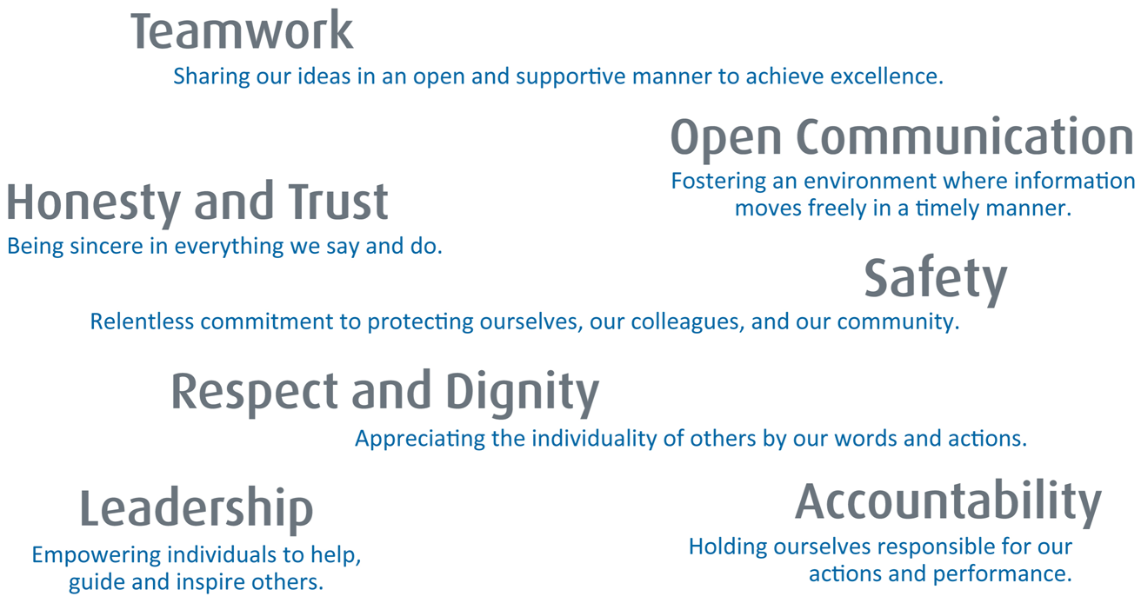
A proud, diverse energy company, whose people are committed
to building a bright future for Newfoundland and Labrador,
unified by our core values.

